Slide 1
Elementary Sorting Methods

Slide 2
Sorting
A Sorting Algorithm: is an algorithm that puts elements of a list into order.
Sorting rearranges the elements into either ascending or descending order within the array.

Slide 3
Sorting Terminology and Notation
Some Sorting Problem allows input with two or more records that have the same key value. Other applications require that input not contain duplicate key values.
When duplicate key values are allowed, there might be an implicit ordering to the duplicates, typically based on their order of occurrence within the input.
A stable sorting algorithm is that does not change the relative ordering of records with identical key values.

Slide 4
Example: Stable Sorting Algorithm
Original List |  | Sorted by method1 |  | Sorted by method2
name | class | name | class | name | class
Adam | 1 | Adam | 1 | Adam | 1
Black | 2 | Smith | 1 | Smith | 1
Brown | 4 | Washington | 2 | Black | 2
Jackson | 2 | Jackson | 2 | Jackson | 2
Jones | 4 | Black | 2 | Washington | 2
Smith | 1 | White | 3 | White | 3
Thompson | 4 | Wilson | 3 | Wilson | 3
Washington | 2 | Thompson | 4 | Brown | 4
White | 3 | Brown | 4 | Jones | 4
Wilson | 3 | Jones | 4 | Thompson | 4
 |  | non-stable method |  | stable method

Slide 5
Insertion Sort
Definition: in each iteration of an insertion sort remove an element from the input data and insert it at the correct position in the already sorted list, until no element are left in the input.
The algorithm:
Start with the result (sorted list) being the first element of input.
Remove an element from unsorted list (the left most element) compare it with the right most element in the sorted list.
If the removed element is smaller than the current sorted element, swap them.
Otherwise, the new element is in the correct location.
Repeat step 2-4 until the unsorted list is empty.

Slide 6
Insertion Sort (click here)
List | i = 1 | i=2 | i=3 | i=4 | i=5 | i=6 | i=7 | i=8
68 | 34 | 15 | 15 | 15 | 6 | 6 | 6 | 6
34 | 68 | 34 | 34 | 34 | 15 | 15 | 15 | 10
15 | 15 | 68 | 68 | 59 | 34 | 34 | 29 | 15
126 | 126 | 126 | 126 | 68 | 59 | 59 | 34 | 29
59 | 59 | 59 | 59 | 126 | 68 | 68 | 59 | 34
6 | 6 | 6 | 6 | 6 | 126 | 83 | 68 | 59
83 | 83 | 83 | 83 | 83 | 83 | 126 | 83 | 68
29 | 29 | 29 | 29 | 29 | 29 | 29 | 126 | 83
10 | 10 | 10 | 10 | 10 | 10 | 10 | 10 | 126
An illustration of insertion sort. Each column shows the array after the iteration with the indicated value i in the outer for loop. The filled numbers in each column have been sorted. Arrows indicate the upward motions of records through the array

Slide 7
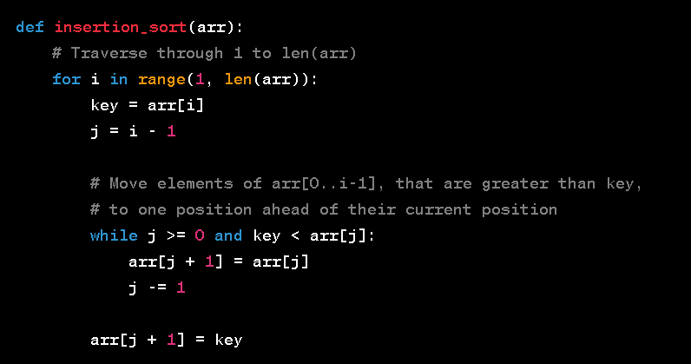
Insertion Sort - Code
The running time of insertion sort is O(n²)

Slide 8
Bubble Sort
Definition: It is a simple sorting algorithm. It compares adjacent items at a time, and swaps them in the correct order if necessary. Bubble sort gets its name from the fact that the smaller items tend to move up into the correct order like bubbles rising to the surface
The algorithm:
Compare adjacent elements. If the second is smaller than the first, swap them. Do this for each pair of adjacent elements, starting from the last two. At this point the first element should be the smallest.
Repeat the step for all elements except the first one.
Keep repeating for fewer elements each time, until you have no more pairs to compare.

Slide 9

Bubble Sort (click here)
 | i = 0 | i=1 | i=2 | i=3 | i=4 | i=5 | i=6 | i=7
68 | 6 | 6 | 6 | 6 | 6 | 6 | 6 | 6
34 | 68 | 10 | 10 | 10 | 10 | 10 | 10 | 10
15 | 34 | 68 | 15 | 15 | 15 | 15 | 15 | 15
126 | 15 | 34 | 68 | 29 | 29 | 29 | 29 | 29
59 | 126 | 15 | 34 | 68 | 34 | 34 | 34 | 34
6 | 59 | 126 | 29 | 34 | 68 | 59 | 59 | 59
83 | 10 | 59 | 126 | 59 | 59 | 68 | 68 | 68
29 | 83 | 29 | 59 | 126 | 83 | 83 | 83 | 83
10 | 29 | 83 | 83 | 83 | 126 | 126 | 126 | 126
An illustration of bubble sort. Each column shows the array after the iteration with the indicated value i in the outer for loop. The filled numbers in each column have been sorted.

Slide 10
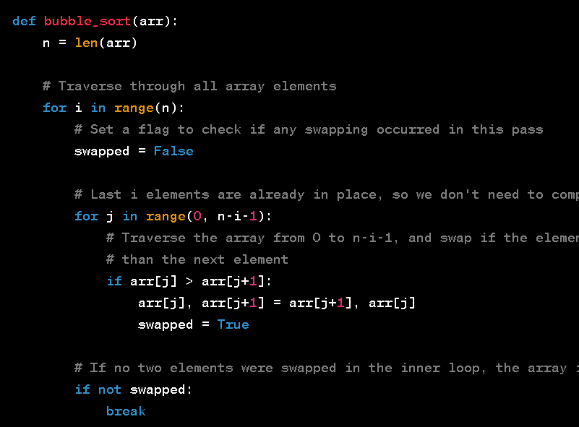
Bubble Sort - Code

Slide 11
Selection Sort
Definition: It is a simple sorting algorithm. It finds the smallest element in the array and exchanges it with the element at the first position of the array. After that it finds the second smallest element and exchanges it with the second position. Continue in this way until the entire array is sorted.
In the sorting method divides the set of data into two parts: already sorted, and not yet sorted (before sorting you have an empty sorted part and the whole unsorted set of data).
The algorithm:
Scan the unsorted part of the data.
Select the smallest value.
Switch the smallest value with the first value in the unsorted list.
Repeat the previous steps until there are no element in the unsorted list (or all the elements are sorted).

Slide 12
Selection Sort (click here)
 | i = 0 | i=1 | i=2 | i=3 | i=4 | i=5 | i=6 | i=7
68 | 6 | 6 | 6 | 6 | 6 | 6 | 6 | 6
34 | 34 | 10 | 10 | 10 | 10 | 10 | 10 | 10
15 | 15 | 15 | 15 | 15 | 15 | 15 | 15 | 15
126 | 126 | 126 | 126 | 29 | 29 | 29 | 29 | 29
59 | 59 | 59 | 59 | 59 | 34 | 34 | 34 | 34
6 | 68 | 68 | 68 | 68 | 68 | 59 | 59 | 59
83 | 83 | 83 | 83 | 83 | 83 | 83 | 68 | 68
29 | 29 | 29 | 29 | 126 | 126 | 126 | 126 | 83
10 | 10 | 34 | 34 | 34 | 59 | 68 | 83 | 126
An illustration of selection sort. Each column shows the array after the iteration with the indicated value i in the outer for loop. The filled numbers in each column have been sorted in their final position.

Slide 13
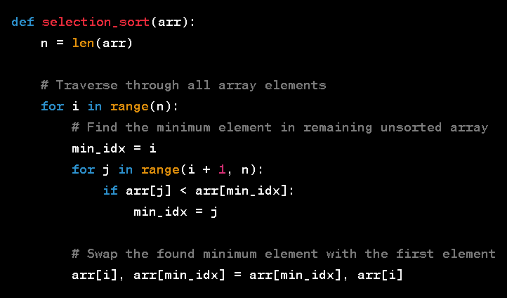
Selection Sort - Code

Slide 14
A comparison of the asymptotic complexities for three simple sorting algorithms
 | Insertion | Bubble | Selection
Comparison
Best case | O(n) | O(n²) | O(n²)
Average case | O(n²) | O(n²) | O(n²)
Worst case | O(n²) | O(n²) | O(n²)
Swaps
Best case | 0 | 0 | O(n)
Average case | O(n²) | O(n²) | O(n)
Worst case | O(n²) | O(n²) | O(n)

Slide 15
Simple Sorting Methods
We may choose a simple method instead a general-purpose methods for the following reasons:
We often use a sorting program only once or just few times.
Elementary methods are always suitable for small files (say less than few hundred elements).
Other types of files that are easy to sort are ones that already almost sorted (or already are sorted) or ones that contain large number of duplicate keys.
These elementary methods are not suitable for large, randomly arranged files, because the running time will become excessive even on the fastest computers.
May see Merge sort / Quick sort

Slide 16
Exercise: Sort List of Students by GPA using Insertion Sort
You are given a list of students, each represented as a dictionary with the following attributes: name, age, and gpa. Your task is to sort the list of students based on their GPA in descending order using the Insertion Sort algorithm.
Example of a student dictionary:
students = [
{"name": "Alice", "age": 20, "gpa": 3.9},
{"name": "Bob", "age": 22, "gpa": 3.7},
{"name": "Charlie", "age": 21, "gpa": 4.0},
{"name": "David", "age": 19, "gpa": 3.5},
]

